Slide 1
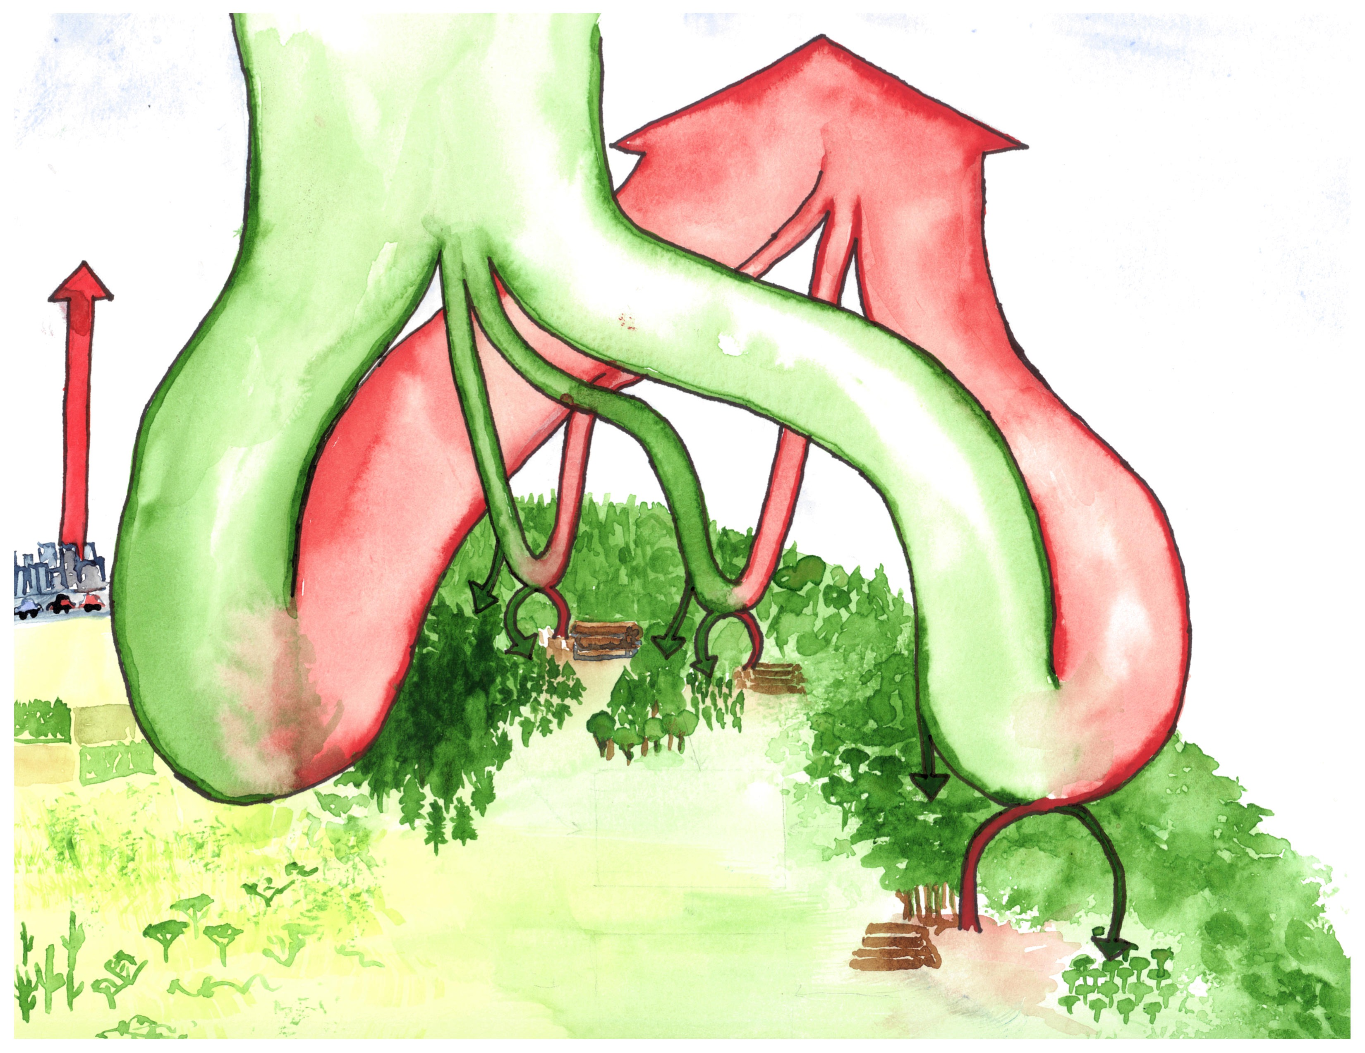
ecosystem respiration + fire
atmosphere
873
gross primary production
Fluxes Gt C yr⁻¹
Stocks Gt C
-121.6
+120.3 – 120.4
fossil fuels
+9.4
+62.6
+7.8
+40.7-40.9
+9.1
-62.6
-40.8
-8.3
-9.9
boreal forests
temperate forests
non-forest
biomass 54-88
biomass 47-59
tropical forests
-0.5
-0.8
intact forest sink
-2.3
-1.0 – 1.4
biomass
211-262
biomass
31-107
deforestation + degradation
+0.9 - 2.8
regrowth
-1.6 – 1.7
net terrestrial sink
-1.2 - 1.3
net deforestation
+1.1
Notes:
Most recent estimates from each source.
Ecosystem respiration + fire are my calculations based on change estimate for each biome

